Slide 1
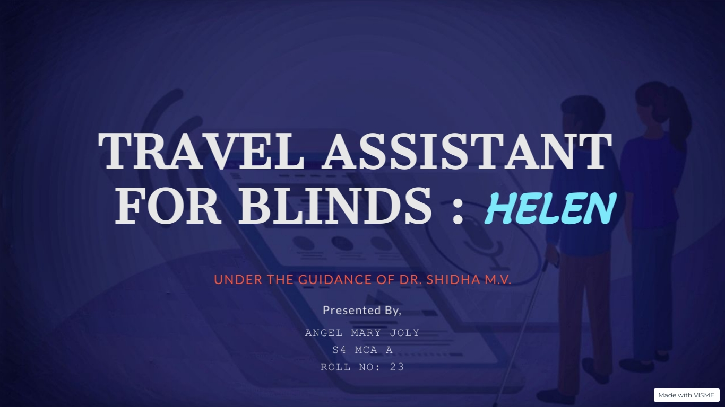

Slide 2

TRAVEL INDEPENDENTLY : Visually impaired people face many problems in their day to day lives. Among them, travelling is one of the major concerns. In this application the blinds can travel through the bus independently without any assistance of people. Public bus transport information system for visually impaired people suggests a more accurate and cost-effective idea to ensure safe journey of the visually challenged by utilizing the vast possibilities of smartphone applications.

Slide 3

This system consists of three main parts – Passenger, Conductor and Server.
Passenger can provide destination through voice message.
Server will find out the appropriate bus.
Conductor will have the list of users requested for the bus.
Front end : Android
Back end: MongoDB

Slide 4

MAIN OBJECTIVE:
To help visually impaired people travel independently.
SUB OBJECTIVES:
1. Using Google Speech to Text converter for accepting destination.
2. A server is used to store the bus details.
3. Enable GPS tracking from the device of both users.

Slide 5

The existing system provides actual position and nearby places of the user with the help of GPS.
It allow user to find nearby places from a specific category such as banks, health, shop, etc.
It does not support speech-to-text function.
There is only one type of user for this application.

Slide 6
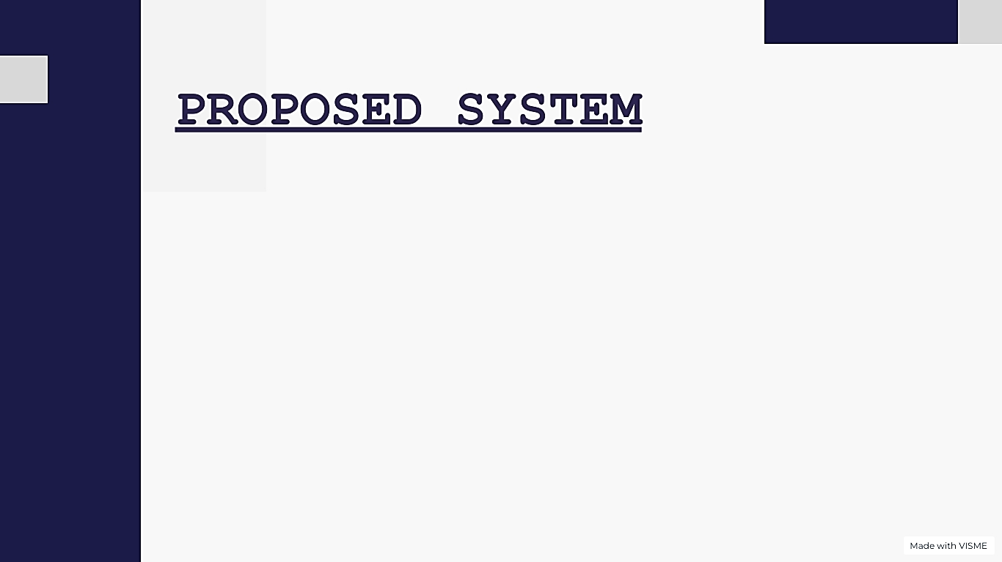
The proposed system can be developed using GPS by providing all it’s usability.
The system consists of two users passenger and conductor.
It supports Google speech-to-text function.
Through this system blind passenger can travel through public bus transportation.
Passenger can provide destination through voice message and it will pass to the server.
The server decides the bus and send message to the conductor.
Conductor will give an acknowledgment to the passenger.

Slide 7

Passenger :
Conductor :
Registration
Login
Set destination
View conductors going to same destination
Set profile
Registration
login
Set destination
View passengers going to same destination
Set profile

Slide 8
Voice command :
Location :
To ask the destination of passenger
Update current destination of passenger and conductor

Slide 9

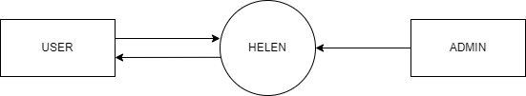
DATA FLOW DIAGRAM
LEVEL 0

Slide 10
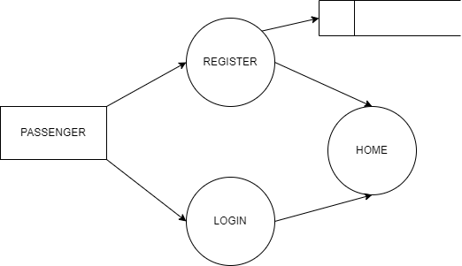
LEVEL 1 : Passenger
1.0
Passenger details
3.0
2.0

Slide 11
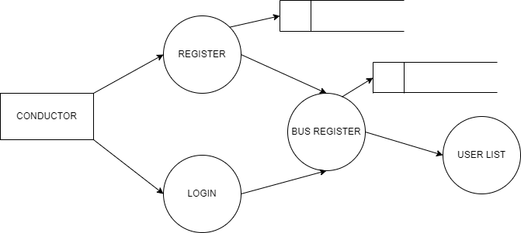
LEVEL 1 : Conductor
Conductor details
4.0
Bus details
6.0
7.0
5.0

Slide 12
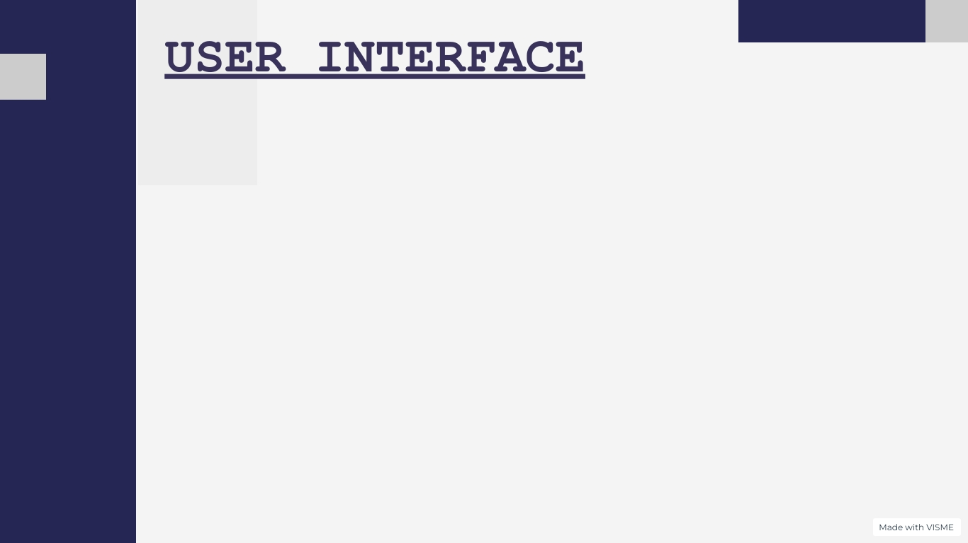

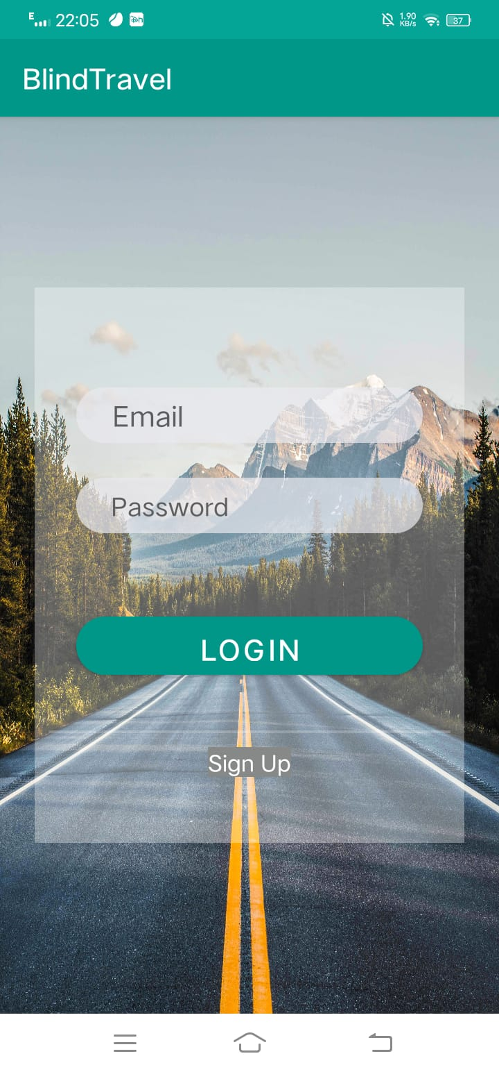
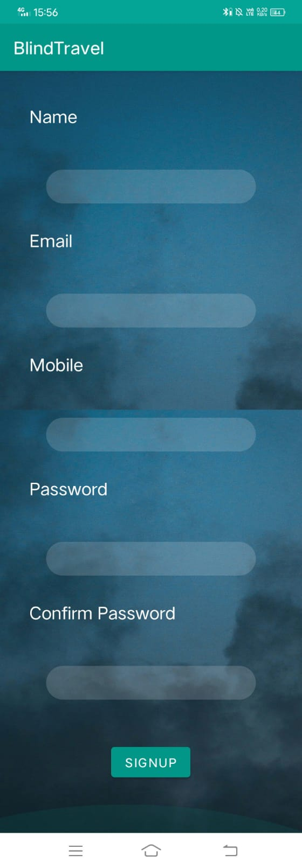
SPLASH
LOGIN
REGISTER

Slide 13
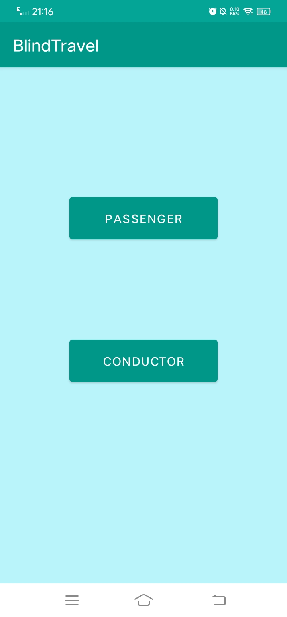
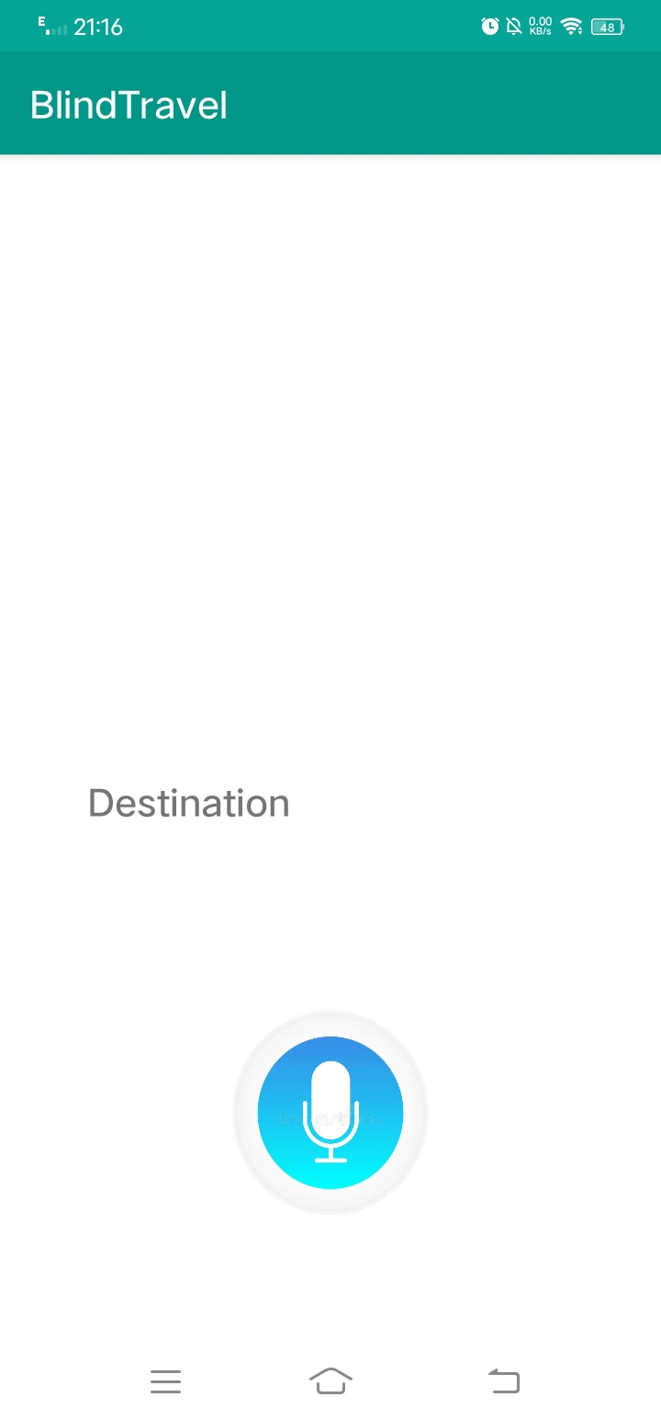
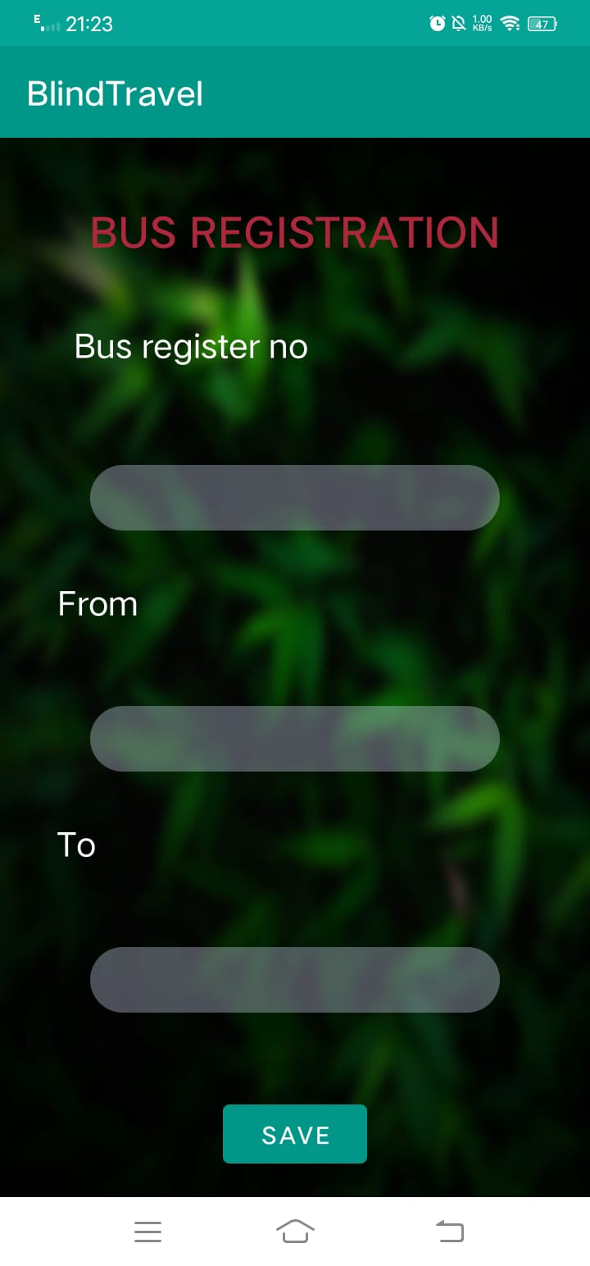
HOME
PASSENGER HOME
BUS REGISTER

Slide 14


